Slide 1
PRESIDENCY UNIVERISTY, BENGALURU, School of Engineering
Computer Organization and Architecture
CSE 2009
Module-2: Instruction Set Architecture and Memory Unit

Slide 2
Addressing modes
The different ways in which the location of an operand is specified in an instruction are referred to as addressing modes.
We can access an operand by specifying the name of the register or the address of the memory location where the operand is located.

Slide 3
Different types of addressing modes
Immediate mode
Register mode
Absolute mode (Direct mode)
Indirect mode
Index mode
Base with index
Base with index & offset
Relative mode
Auto-increment mode
Auto-decrement mode

Slide 4
Immediate mode:
The operand is given explicitly in the instruction.
e.g. MOV 200_{immediate},R0
The immediate mode is only used to specify the value of a source operand. Using a subscript to denote the immediate mode is not appropriate in assembly languages.
A common convention is to use the sharp sign (#) in front of the value to indicate that this value is to be used as an immediate operand.
Hence we write the instruction above in the form
MOV #200,R0
add #6,R1

Slide 5
Register Mode:
The operand is the contents of a processor register, the name(address) of the register is given in the instruction.
e.g. MOV R1,R2
The instruction copies the contents of register R1 to register R2.

Slide 6
Absolute mode (Direct mode):
The operand is in a memory location; the address of this location is given explicitly in the instruction
The instruction uses two modes.
E.g. MOV LOCA,R2
ADD A,B

Slide 7
Indirect mode:
In this addressing mode, the instruction does not give the operand or its address explicitly. instead it provides information from which the memory address of the operand can be determined. we refer to this address as the effective address(EA) of the operand.
To execute the add instruction in the figure(A) the processor uses the value B, which is in the register R1, as the effective address of the operand. the value read is desired operand, which the processor adds to the contents or register R0.

Slide 8
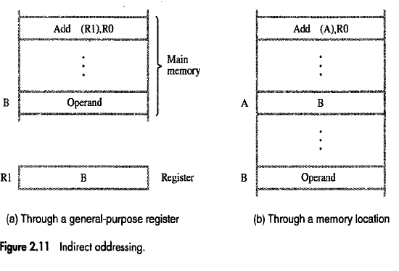

Slide 9
Indirect addressing through a memory location is also possible as shown in the figure(b). In this case processor first reads the contents of memory location A, then requests a second read operation using the value B as an address to obtain the operand.
The register or memory location that contains the address of an operand is called a pointer.

Slide 10
Indexing and arrays
So far we discussed register mode, absolute mode, immediate mode & indirect mode.
These are best suited when we are dealing with constants, variables & pointers.
But these are not the efficient when we are dealing with arrays and lists.

Slide 11
Index mode :
In this mode, effective address of the operand is generated by adding a constant value to the contents of a register.
The register used in this mode is called index register which may be a special purpose register or any one of the general purpose register.
We indicate the index mode symbolically as
X(R_{i})
X→ denotes the constant value in the instruction,
Ri is name of the register involved.
Effective address of the operand is given by
EA = X+[Ri]

Slide 12
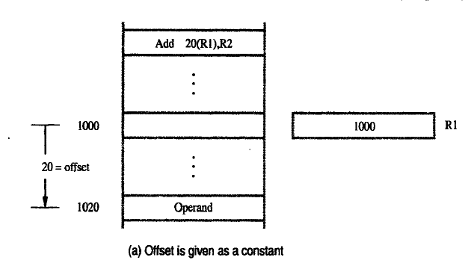

Slide 13
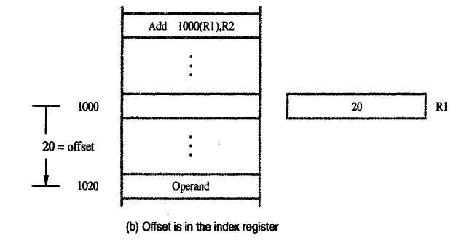

Slide 14
Figure illustrates two ways of using the index mode.
In figure A the index register R1, contains the address of a memory location and the value X defines an offset(also called displacement)
In figure B, the constant X corresponds to a memory address, and the contents of the index register define the offset to the operand.

Slide 15
Base with Index Mode
In this addressing mode Effective Address is the sum of two registers.
Syntax:
(R_{i},R_{j})
Effective Address:
EA= [R_{i}]+[R_{j}]
The first register is called Index Register.
The second register is called Base Register.

Slide 16
Base with Index and Offset
Another variation uses 2 registers and a constant .
In this addressing mode effective address is the sum of the constant(X) and the contents of the two registers.
Syntax:
X(R_{i},R_{j})
EA=X+[R_{i}]+[R_{j}]
this way is more useful in accessing multiple components inside each item ( Ex: multi dimensional arrays)

Slide 17
Relative Addressing:
In index addressing mode, we used one of the GPR.
Instead of GPR, if we use program counter (PC), then it is known as relative addressing mode.
EA=[PC]+X
The effective address is determined by the index mode using the program counter in the place of the general purpose register.

Slide 18
Additional Modes
Many computers provide two additional modes:
1) Autoincrement Mode
2) Autodecrement Mode
Autoincrement mode:
The effective address of an operand is contents of register specified in the instruction. After accessing the operand, the contents of the register are automatically incremented to point to the next item in the list.
(Ri)+

Slide 19
Autodecrement mode:
The contents of a register specified in the instruction are first automatically decremented and are then used as the effective address of the operand.
Thus we write
-(Ri)

Slide 20
STACK
A stack is a list of data elements.
Elements can be added or removed at one end of the list only, called as TOP of the STACK, and the other end is called the bottom.
It referred to as a pushdown stack or last –in first –out(LIFO).

Slide 21
PUSH:
Placing a new item on the stack.
POP:
Removing the top item from the stack.
STACK POINTER(SP)- A processor register to keep track of the address of the element of the stack at the top at any given time.

Slide 22
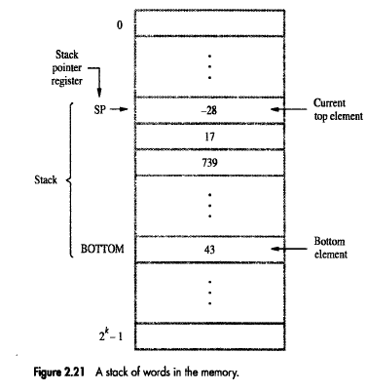

Slide 23
If we assume a byte addressable memory with 32-bit word length the push operation can be implemented as
Subtract #4,SP
Move NEWITEM,(SP)
These two instructions move the word from location NEWITEM onto the top of the STACK decrementing the stack pointer before the move.

Slide 24
The POP operation can be implemented as
Move (SP), ITEM
Add #4,SP
These two instructions move the top value from the stack into the location ITEM and then increment the stack pointer by 4

Slide 25
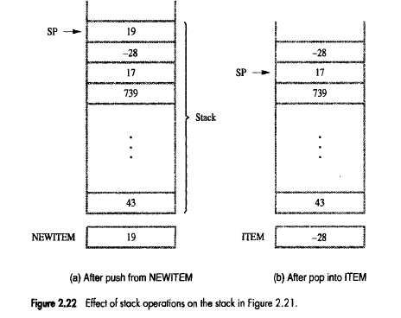

Slide 26
If the processor has the autoincrement and autodecrement addressing modes the push operation can be performed by the single instruction
MOVE NEWITEM, -(SP)
And pop operation can be performed by
MOVE (SP)+, ITEM

Slide 27
To prevent either pushing an item on a full stack or popping an item off an empty stack the single instruction push and pop operations can be replaced by the instruction sequences shown in the figure.

Slide 28
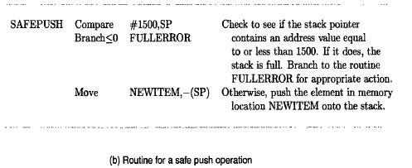
SAFE PUSH

Slide 29
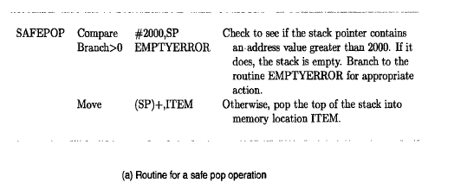
SAFEPOP

Slide 30
SUBROUTINES
A subroutine is a group of instructions, performs a particular subtask which is executed number of times. It is written separately.
The processor executes this subroutine by transferring the program control to the subroutine program.
After completion of subroutine program execution, the program control is returned back to the main program.

Slide 31
A subroutine (or procedure/function) is a block of code that performs a specific subtask and can be invoked multiple times from different points in a program.
Control jumps to the subroutine when called and returns after completion.
This avoids repetition of code and improves modularity and clarity.

Slide 32
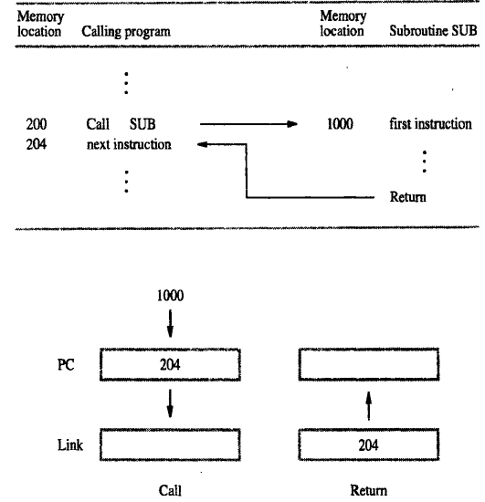

Slide 33
CALL Instruction:
The call instruction performs the following operations
Store the contents of the Program counter(PC) in the link register.
Branch to the target address specified by the instruction.
RETURN Instruction:
Loads the program counter(PC) with the contents of link register and branch to that address.

Slide 34
Subroutine Nesting
When one subroutine calls another subroutine to complete a particular task, the operation is called NESTING.
Calling program SUB1 SUB2
1 1 1
2 2 2
3 3 3
CALL SUB1 CALL SUB2 4
5 5 5
6 RET
RET

Slide 35
In this case, the return address(RA) of the second call is also stored in the link register, destroying its previous contents.
Subroutine Nesting
Definition:
Subroutine nesting occurs when one subroutine calls another subroutine before finishing its own execution.
Key idea:
The stack is used to store return addresses so that control can properly return step by step.

Slide 36
Parameter Passing
When calling a subroutine, a program must provide to the subroutine the parameters.
This exchange of information between a calling program and a subroutine is referred to as parameters passing.
Parameters passing may be accomplished in several ways.
The parameters may be placed in registers or in memory locations, where they can be accessed by subroutine

Slide 37
Passing Parameters Through Registers.
Passing parameters through registers is straight forward and efficient.
Figure shows how the program for adding a list of numbers can be implemented as subroutine.

Slide 38
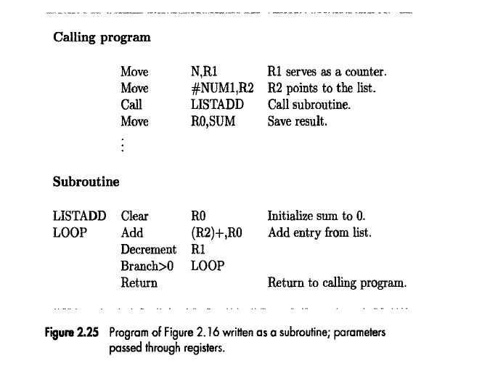

Slide 39
Move N, R1 ; R1 = counter (number of elements in the list)
Move #NUM1, R2 ; R2 = pointer to the first list element
Call LISTADD ; Call subroutine to compute sum
Move R0, SUM ; Store result (sum) into memory
Meaning:
R1 tells how many elements to add.
R2 points to the starting address of the list.
R0 will hold the final sum (returned by subroutine).
LISTADD Clear R0 ; Initialize sum = 0
LOOP Add (R2)+, R0 ; Add current element into R0, auto-increment R2 Decrement R1 ; Reduce counter
Branch>0 LOOP ; If R1 > 0, repeat
Return ; Go back to calling program

Slide 40
Meaning:
Clear R0 → sum initialized to 0.
Add (R2)+, R0 → add list element to sum and increment pointer R2.
Decrement R1 → reduce number of items left.
Branch>0 LOOP → if still items left, continue.
Return → execution resumes in calling program (after CALL).
Parameter Passing (through Registers)
Input parameters:
  R1 → number of elements
  R2 → address of first element
Output parameter:
  R0 → result (sum)
No stack or memory-based passing here → fast but limited, only works if few registers are needed.

Slide 41
If many parameters are involved, there may not be enough general-purpose registers available for passing them to the subroutine.

